Slide 1
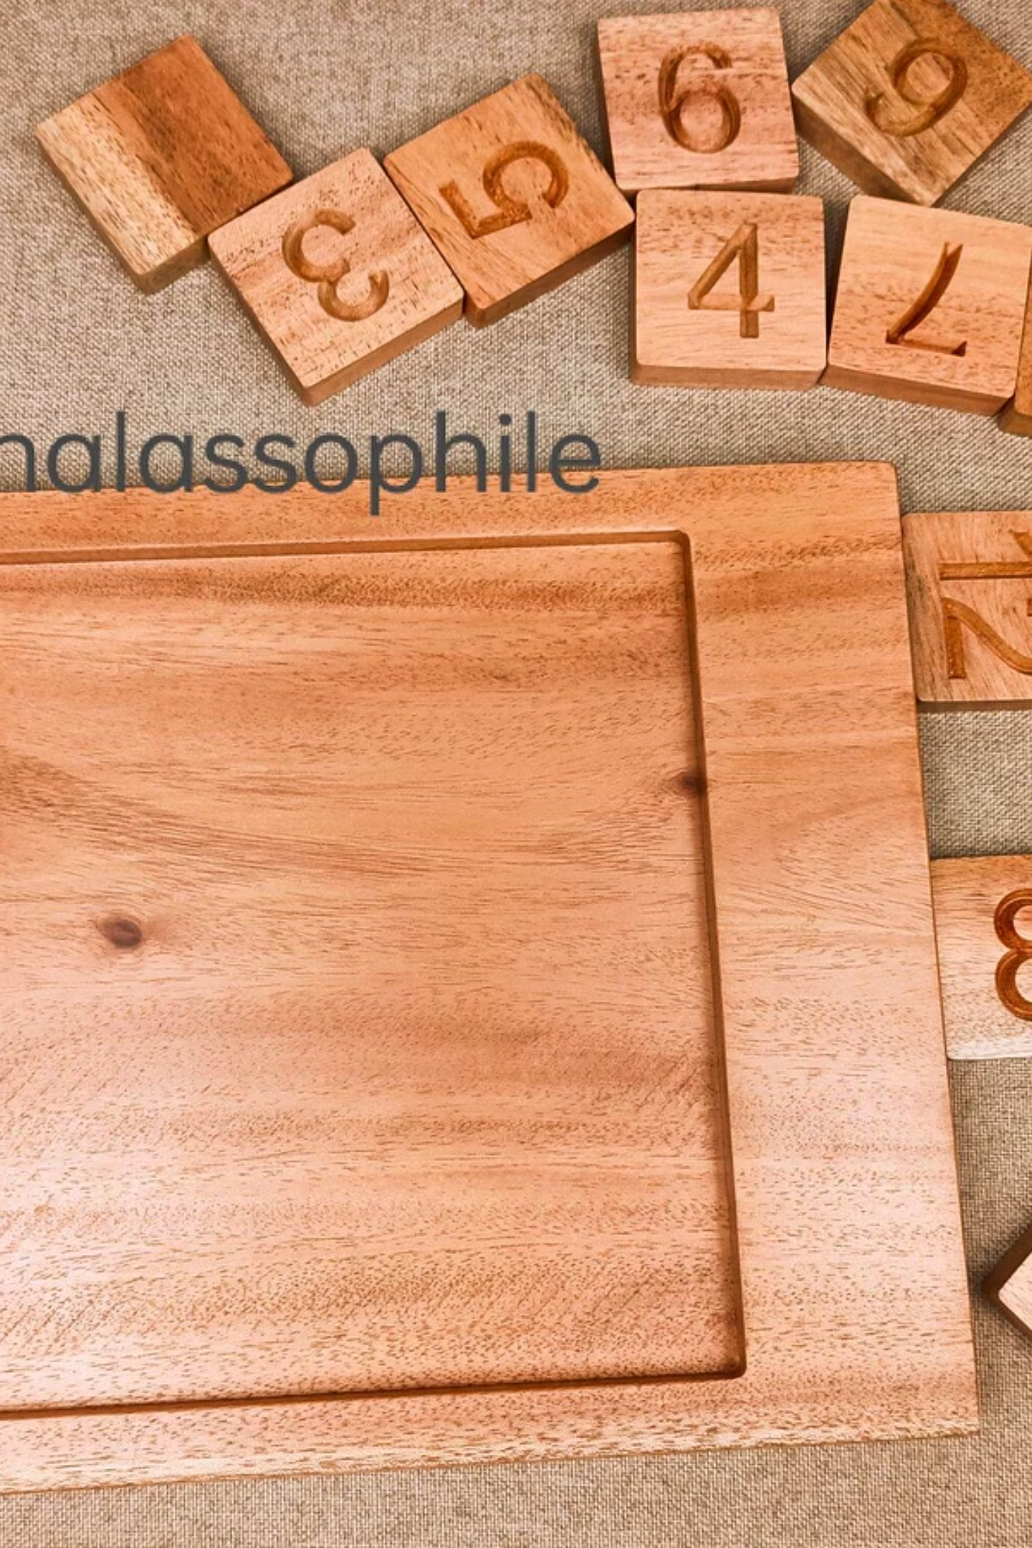

Solving the N-Puzzle Game Using the A* Search Algorithm
Farah El KhatibCE368 - Artificial IntelligenceSeptember 2025
Implementation Language: C Programming

Slide 2
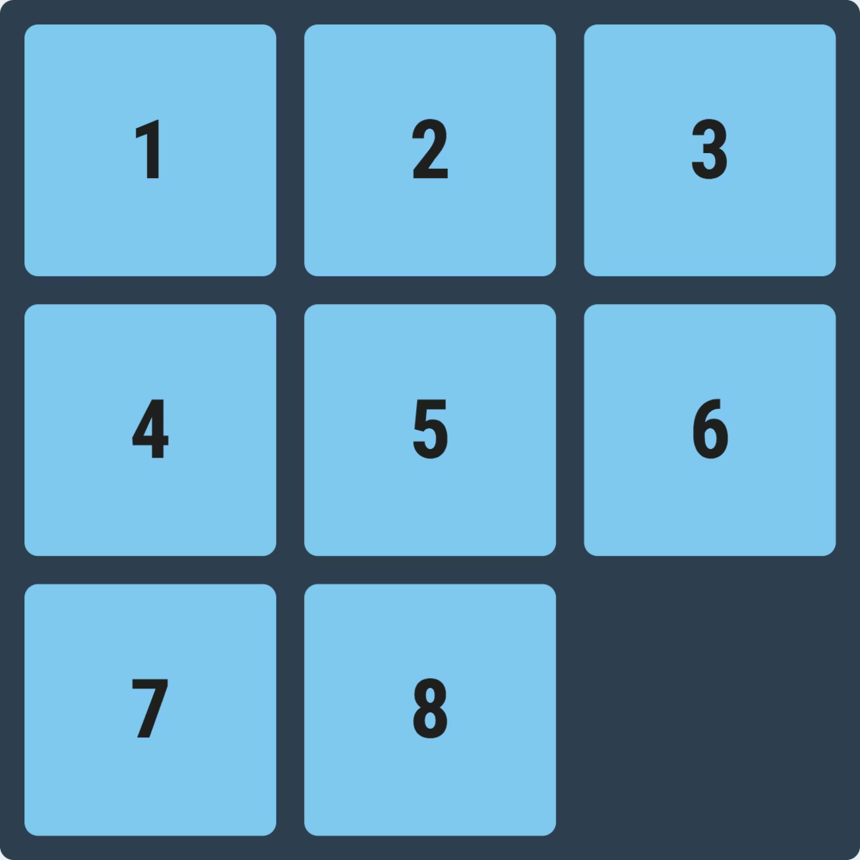
Introduction to the N-Puzzle: A Classic AI Challenge
What is the N-Puzzle?
The N-puzzle is a sliding puzzle game consisting of numbered tiles arranged in a square grid with one empty space. Players slide tiles into the empty space to arrange them in numerical order. The most famous variants include the 8-puzzle (3×3 grid) and the 15-puzzle (4×4 grid).
This seemingly simple game has profound significance in artificial intelligence research. Introduced in the 1870s, the 15-puzzle became one of the first problems to demonstrate the complexity of state-space search algorithms. It serves as a perfect benchmark for testing search strategies because it has a well-defined state space, clear goal conditions, and varying levels of difficulty.
The puzzle's importance extends beyond entertainment—it represents a class of problems where finding the optimal solution requires intelligent search strategies rather than brute force approaches. This makes it an ideal testbed for comparing different AI algorithms and heuristics.
Example: 8-puzzle with tiles 1-8 and one empty space. Goal is to arrange tiles in ascending order.

Slide 3
Problem Definition: Formalizing the Puzzle
State Representation
Initial vs Goal States
Complexity Analysis
Each puzzle configuration is represented as a 2D matrix or flattened array. For an 8-puzzle, we use a 3×3 grid where each cell contains either a number (1-8) or represents the empty space (typically 0).
The initial state is the starting configuration given to us. The goal state is typically arranged as: [[1,2,3],[4,5,6],[7,8,0]] for the 8-puzzle.
The 8-puzzle has 9! = 362,880 possible states, but only half are actually solvable. The 15-puzzle explodes to over 20 trillion possible states!
The challenge is finding the sequence of moves that transforms the initial state into the goal state with minimum steps.
Branching factor varies from 2-4 moves per state, making naive search approaches computationally expensive for larger puzzles.
Example state: [[1,2,3],[4,0,5],[7,8,6]] represents a nearly solved puzzle with the empty space in the middle.

Slide 4
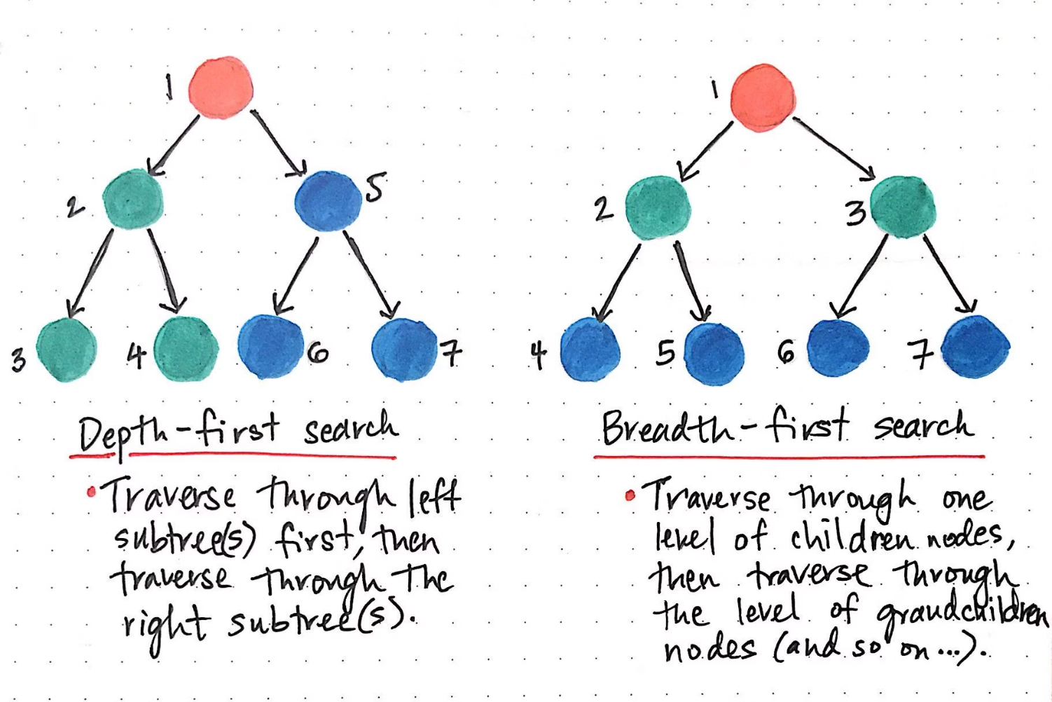
Why A* Search? The Smart Choice for Optimal Solutions
Limitations of Traditional Approaches
Breadth-First Search (BFS): Guarantees optimal solution but explores all nodes at each level, consuming massive memory
Depth-First Search (DFS): Memory efficient but may find suboptimal solutions or get stuck in deep paths
Uniform-Cost Search: Optimal but doesn't use problem-specific knowledge to guide search
A* Advantages
A* combines the optimality guarantee of BFS with the efficiency of informed search. It uses heuristic knowledge to guide the search toward the goal, dramatically reducing the number of nodes explored.
f(n) = g(n) + h(n)
g(n): Actual cost from start to node nh(n): Heuristic estimate from n to goalf(n): Estimated total cost of path through n
The key insight is that A* uses the heuristic function h(n) to estimate the remaining cost to reach the goal. When this heuristic is admissible (never overestimates), A* is guaranteed to find the optimal solution while exploring fewer nodes than uninformed search methods.

Slide 5
Heuristic Functions: The Brain Behind A* Intelligence
1
2
3
Misplaced Tiles Heuristic
Manhattan Distance Heuristic
Performance Comparison
Counts the number of tiles not in their goal positions. Simple to compute but less informative.
Calculates the sum of distances each tile must travel to reach its goal position (moving only horizontally and vertically).
Manhattan distance typically reduces the search space by 50-70% compared to misplaced tiles for most puzzle configurations.
Example: If 3 tiles are out of place, h(n) = 3. This heuristic is admissible since we need at least 3 moves to solve the puzzle.
Example: If tile 5 is at position (0,1) but should be at (1,2), its Manhattan distance is |0-1| + |1-2| = 2.
Both heuristics are admissible (never overestimate) and consistent (satisfy triangle inequality), ensuring A* optimality.
Pros: More accurate estimate, fewer node expansionsCons: Slightly more computation per node
Pros: Fast computation, low memoryCons: Underestimates actual cost, leading to more node expansions

Slide 6
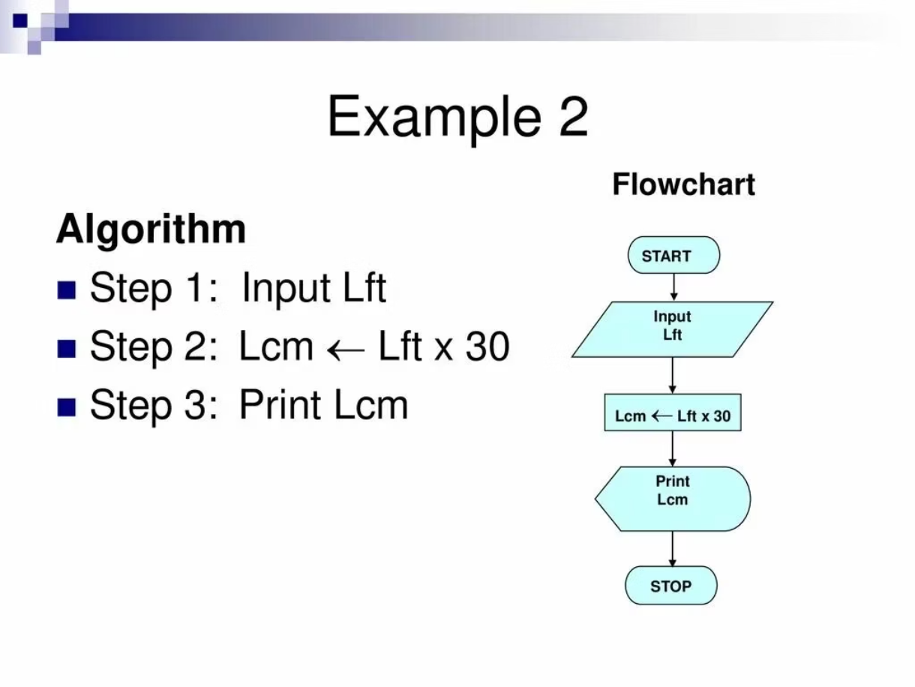

Algorithm Workflow: Step-by-Step A* Process
01
Initialize
Create priority queue (min-heap) and add the initial state with f(n) = g(n) + h(n). Set g(start) = 0.
02
Select Node
Remove the node with lowest f(n) value from the priority queue. This is our most promising candidate.
03
Goal Check
If selected node matches goal state, reconstruct the solution path and terminate successfully.
04
Expand
Generate all valid successor states by moving the empty tile in possible directions (up, down, left, right).
Key Insight: The priority queue ensures we always explore the most promising path first, while the heuristic guides us toward the goal efficiently.
05
Evaluate
For each successor, calculate g(n) = parent_g + 1 and h(n) using chosen heuristic. Add to queue if not visited or if better path found.
06
Repeat
Continue until goal found or queue empty (no solution exists).

Slide 7
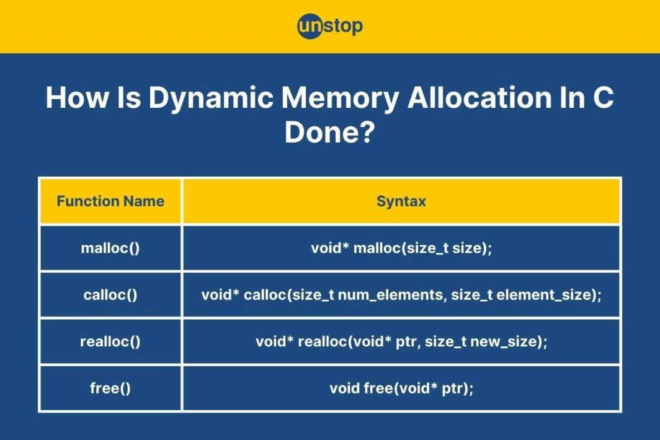

Implementation in C: Low-Level Optimization Challenges
Core Data Structures
typedef struct PuzzleNode { int state[3][3]; // Puzzle configuration int g_cost; // Path cost from start int h_cost; // Heuristic estimate int f_cost; // g_cost + h_cost struct PuzzleNode* parent; // For path reconstruction int empty_row, empty_col; // Position of empty tile} PuzzleNode;typedef struct PriorityQueue { PuzzleNode** heap; int size; int capacity;} PriorityQueue;
C Implementation Gotchas: Manual memory management, pointer arithmetic for 2D arrays, and efficient hashing functions for state comparison.
Memory Management Challenges:
Dynamic allocation for nodes and queue resizing
Preventing memory leaks during search termination
Hash table for visited states to avoid cycles
Efficient heap operations for priority queue
The C implementation requires careful attention to memory management and efficient data structures. Unlike high-level languages, we must manually handle memory allocation, implement priority queues from scratch, and optimize for both time and space complexity. The challenge lies in balancing code readability with performance optimization.

Slide 8
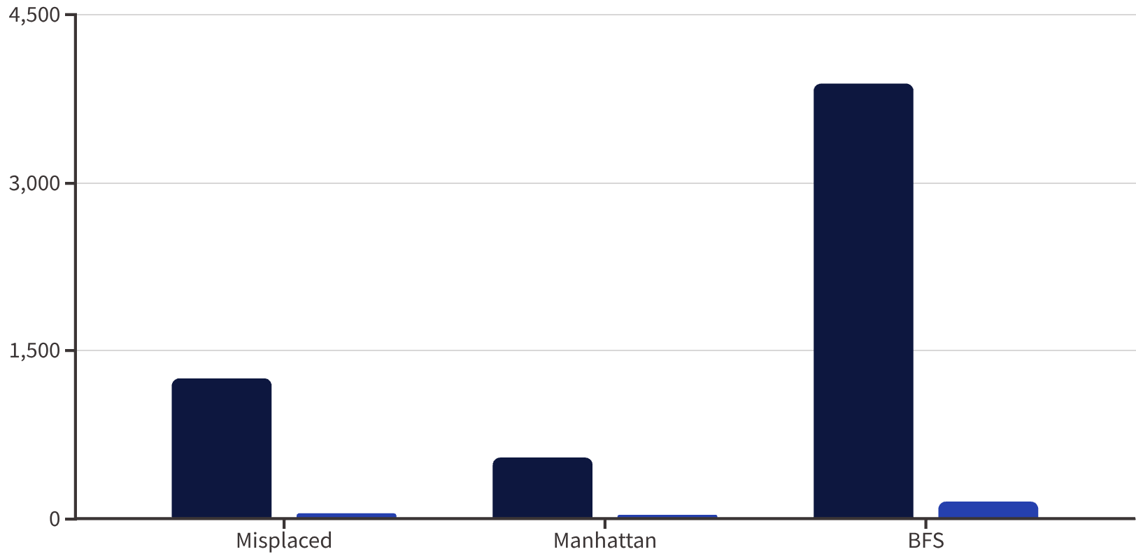
Results & Performance Analysis
Example Solution: 8-Puzzle
Initial State:2 8 31 6 47 0 5
Solution Path (7 moves):
Move 5 left: [2,8,3],[1,6,4],[7,5,0]
Move 4 down: [2,8,3],[1,6,0],[7,5,4]
Move 3 down: [2,8,0],[1,6,3],[7,5,4]
Move 8 left: [2,0,8],[1,6,3],[7,5,4]
Move 2 up: [0,2,8],[1,6,3],[7,5,4]
Nodes Expanded
Time (ms)
Move 1 up: [1,2,8],[0,6,3],[7,5,4]
Continue to goal...
67%
85%
7
Reduction
Efficiency
Optimal Moves
Fewer nodes explored with Manhattan distance vs. misplaced tiles heuristic
Less time compared to uninformed BFS for typical 8-puzzle configurations
Average solution length for randomly generated solvable 8-puzzle instances
The performance data clearly demonstrates A*'s superiority over uninformed search methods. Manhattan distance heuristic consistently outperforms misplaced tiles, reducing both computation time and memory usage while maintaining optimality guarantees.

Slide 9
Limitations & Challenges: When A* Hits the Wall
Memory Explosion Problem
Computational Scalability
Heuristic Dependency
A* stores all generated nodes in memory, leading to exponential space complexity. For 15-puzzle, memory requirements can exceed several gigabytes even with efficient implementations.
While A* is optimal, it becomes impractical for N > 15 due to the massive state space. The 24-puzzle (5×5 grid) has over 10²⁵ possible states.
A*'s performance heavily depends on heuristic quality. Poor heuristics can make A* perform worse than simpler algorithms.
Breaking Point: Standard hardware struggles with 15-puzzle instances requiring >50 moves to solve.
Challenge: Finding admissible heuristics that are both accurate and computationally efficient.
Real Impact: 8-puzzle uses ~50KB memory, 15-puzzle can require >2GB for difficult configurations.
Potential Optimizations
Iterative Deepening A* (IDA*): Uses depth-first search with A*'s evaluation function, reducing memory to O(d) where d is solution depth.
Bidirectional Search: Search simultaneously from start and goal states, potentially halving the search space.
Parallel Processing: Distribute node expansion across multiple threads or processors.
Pattern Databases: Precompute optimal costs for puzzle subproblems, creating more informed heuristics.

Slide 10




Conclusion & Future Directions
Project Outcomes & Key Insights
This implementation successfully demonstrated A*'s effectiveness for solving N-puzzle games, achieving optimal solutions with significantly fewer node expansions than uninformed search methods. The Manhattan distance heuristic proved superior to misplaced tiles, reducing computational overhead by approximately 60% while maintaining solution optimality.
The C implementation revealed important lessons about low-level optimization: careful memory management, efficient data structures, and the critical balance between algorithmic elegance and practical performance constraints.
Why Heuristics Matter
The power of A* lies not just in its optimality guarantee, but in its ability to incorporate domain knowledge through heuristic functions. This project reinforces a fundamental AI principle: intelligent search is about knowing where to look, not just how to look.
Hybrid Heuristics
Parallel A*
Real-World Applications
Combining multiple heuristic functions (e.g., Manhattan distance + linear conflicts) for more accurate cost estimation.
Implementing multi-threaded node expansion to leverage modern multi-core processors for larger puzzles.
Applying A* principles to robotics navigation, video game AI, and route optimization in GPS systems.
"The N-puzzle may be a simple game, but it teaches us profound lessons about intelligent problem-solving that extend far beyond sliding tiles."

